Slide 1

COLLECTION
JAVA TRAINING WEEK - 6
By Priyanka Gadwe

Slide 2
Agenda
Collection
List
Set
Queue
Map
Cursor
Java 8 Features
Lamba function
Stream API
Default methods in Interfaces

Slide 3



Collection
Group of individual objects as a
Single entity is called collection .

Slide 4
Need of collection
Due to limitations of array .
Array stores homogenous data only .
Arrays have no underlying data structure .

Slide 5
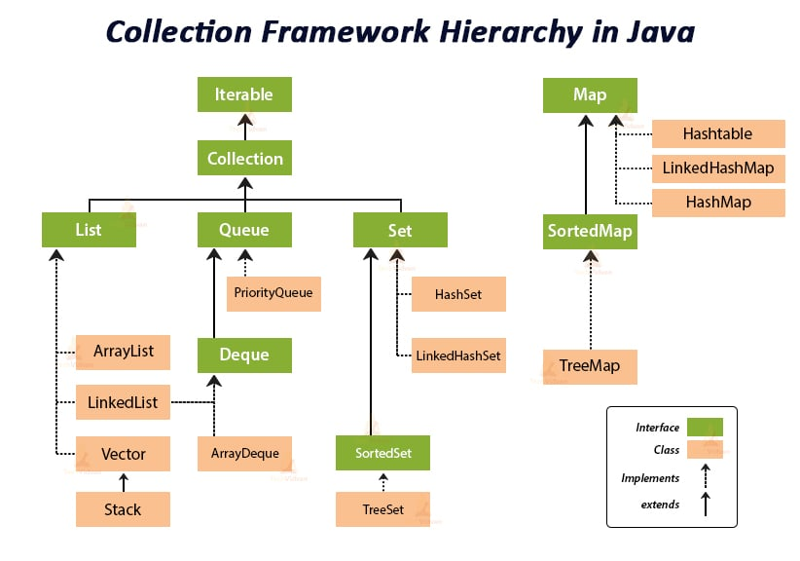

Slide 6
List
Ordered Collection that can contain duplicate elements.
Duplicates identified by index.
Insertion order is preserved .
Provides fast iteration of elements using indexing.
ArrayList

Slide 7
Set
Representing a group of object as a single entity with the condition that –
Duplicates are not allowed
Insertion order is not preserved .
-Hashset

Slide 8
2. Queue
If we want to represent a group of object prior to processing then we should go for Queue .
Eg. Suppose we have to send email to 100 email id’s so we have to store it somewhere and the email send in the same order they stored.
- linked list

Slide 9
map
an object that maps keys to values.
Both the key and value are objects.
A Map cannot contain duplicate keys; each key can map to at most one value.
Value can be duplicate .
-HashMap

Slide 10
Cursors
Iterator (for all collection type)
ListIterator ( for list objects only )
Enumeration ( for legacy classes only )

Slide 11
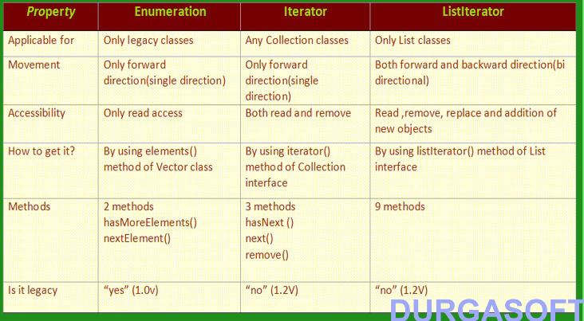

Slide 12
Java 8 Features -
Lambda Function –
Stream API
Function interface
default and static methods in Interfaces
Collection API improvements.
Concurrency API improvements
…

Slide 13
Lambda function
The Lambda expression is used to provide the implementation of an interface which has functional interface.
It saves a lot of code.
In case of lambda expression, we don't need to define the method again for providing the implementation. Here, we just write the implementation code.
Syntax -
No Argument : ()->{}
One Argument : (p1)->{}
Two Argument : (p1,p2)->{}

Slide 14
Stream API
Stream is lazy and evaluates code only when required.
Streams differ from collections in several ways:
No storage. A stream is not a data structure that stores elements; instead, it conveys elements from a source through a pipeline of computational operations.
Functional in nature. An operation on a stream produces a result, but does not modify its source

Slide 15
Default method Interfaces
In java 8 Interfaces are enhanced to have method implementation.
We can use default and static keywords to create interfaces with method implementation.
The concept of default method is used to define a method with default implementation. You can override default method also to provide more specific implementation for the method.
You can also define static methods inside the interface. Static methods are used to define utility methods.

Slide 16
Points to Self explore -
Java 8 features (Static methods in interface, Optional class, Concurrency Enhancements)
Comparable and Comparator
Serialization – Deserialization

Slide 17
Reference-
How get() and put() methods of HashMap works -https://www.java67.com/2013/06/how-get-method-of-hashmap-or-hashtable-works-internally.html
HashMap in Java - https://www.java67.com/2013/02/10-examples-of-hashmap-in-java-programming-tutorial.html
Java Enumeration, Iterator and ListIterator - https://websparrow.org/java/java-enumeration-iterator-and-listiterator
example#:~:text=Java%20provides%20three%20cursors%20i.e.,advantages%20and%20disadvantages%20as%20well.

Slide 18
Thankyou

Slide 19
Suggestion -
kindly perform as many program as you can to explore diff functions in respective collection.
do not restrict yourself on given questions only .
its completely acceptable if you are not able to solve any of the program but you understood that collection. ultimate aim is to get familiar with collection and not logics building at this stage.

Slide 20
Assesment:
List –
1. WAP(write a program) to store only unique elements in arraylist .
e.g list - [1,2,1,2,1,2,1,2,1]
o/p list- [1,2]
2. create a menu program with following options .
1. add
2.remove
3.display element
4.exit
program should run until user choose 4th option.

Slide 21
Set :
WAP to store only unique elements of array.
i/p int[] arr = {1,2,3,1,2,3,3,3,3}
o/p set= (1,2,3)

Slide 22
Map :
1. WAP to count frequency of give list of digit and alphabet in string .
i/p {1,1,2,2} --> 1= 2, 2=2
believe in yourself --> e=4 , b=1 etc
Queue:
1. reverse First k element of Queue
i/p :
5 (no. of inputs)
1,2,3,4,5
4( no. of elements to revers)
o/p :
4,3,2,1,5

